Slide 1
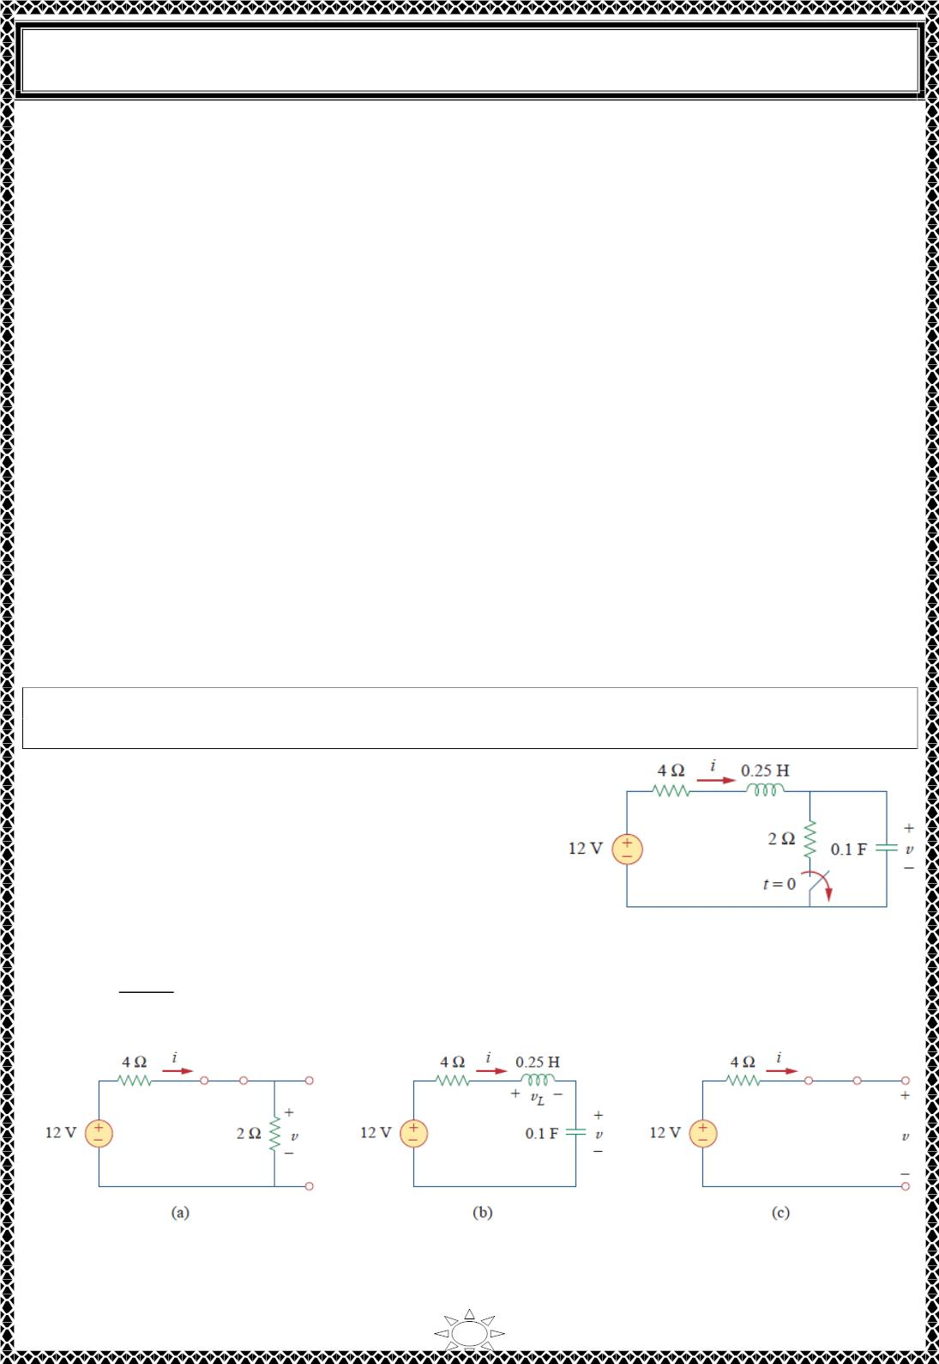
University of Diyala
Engineering College
Electrical Circuits
2) Finding Initial and Final Values
There are two key points to keep in mind in determining the initial conditions. First—as
always in circuit analysis—we must carefully handle the polarity of voltage 푣(푡) across the
capacitor and the direction of the current 푖(푡) through the inductor. Keep in mind that 푣 and
푖 are defined strictly according to the passive sign convention. Second, keep in mind that
the capacitor voltage is always continuous so that
푣(0+) = 푣(0−)
(2.1a)
and the inductor current is always continuous so that
푖(0+) = 푖(0−)
(2.1b)
where 푡 = 0⁻ denotes the time just before a switching event and
푡 = 0+
is the time just
after the switching event, assuming that the switching event takes place at 푡 = 0.
Thus, in finding initial conditions, we first focus on those variables that cannot change
abruptly, capacitor voltage and inductor current, by applying Eq. (2.1). The following
examples illustrate these ideas.
Trail Version
Trail Version
Trail Version
Trail Version
Trail Version
Trail Version
Trail Version
Trail Version
Trail Version
Trail Version
Trail Version
Trail Version
Trail Version
Example 1: The switch in Fig.1 has been closed for a long time. It is open at 푡 = 0. Find:
(a) 푖(0+), 푣(0+), (푏)푑푖(0+)/푑푡, 푑푣(0+)/푑푡, (푐)푖(∞), 푣(∞)
.
Solution:
(a) If the switch is closed a long time before 푡 = 0, it
means that the circuit has reached dc steady state at
푡 = 0. At dc steady state, the inductor acts like a short
circuit, while the capacitor acts like an open circuit, so
we have the circuit in Fig.2 (a) at 푡 = 0⁻. Thus,
Fig.1
푖(0−) =
12
= 2퐴,
푣(0−) = 2푖(0−) = 4푉
4 ꢀ 2
Fig.2 Equivalent circuit of that in Fig.1 for: (a) 푡 = 0^{−, (푏)푡 = 0+, (푐)푡 → ∞.}
2

Slide 2
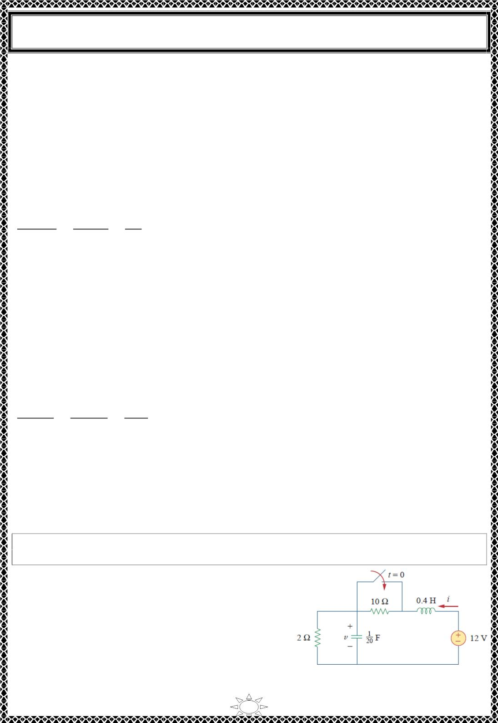
University of Diyala
Engineering College
Electrical Circuits
As the inductor current and the capacitor voltage cannot change abruptly,
푖(0+) = 푖(0−) = 2퐴, 푣(0+) = 푣(0−) = 4푉
(b) At 푡 = 0⁺, the switch is open; the equivalent circuit is as shown in Fig. 2(b). The same
current flows through both the inductor and capacitor. Hence,
푖_{퐶}(0+) = 푖(0+) = 2퐴
Since ꢀ푑푣/푑푡 = 푖 , 푑푣/푑푡 = 푖 /ꢀ, and
퐶
퐶
푑푣(0+) 푖_{퐶}(0+)
=
2
푑푡
ꢀ
=
= 20푉/푠
0.1
Similarly, since 퐿푑푖/푑푡 = 푣 , 푑푖/푑푡 = 푣 /퐿. We now obtain 푣 by applying KVL to the
ꢁ
ꢁ
ꢁ
loop in Fig. 2(b). The result is
ꢂ12 ꢃ 4푖(0+) ꢃ 푣ꢁ(0+) ꢃ 푣(0+) = 0
or
Trail Version
Trail Version
Trail Version
Trail Version
Trail Version
Trail Version
Trail Version
Trail Version
Trail Version
Trail Version
Trail Version
Trail Version
Trail Version
푣ꢁ(0+) = 12 ꢂ 8 ꢂ 4 = 0
Thus,
푑푖(0+) 푣ꢁ(0+)
=
0
푑푡
퐿
=
= 0퐴/푠
0.25
(c) For 푡 > 0, the circuit undergoes transience. But as 푡 → ∞, the circuit reaches steady state
again. The inductor acts like a short circuit and the capacitor like an open circuit, so that the
circuit in Fig. 2(b) becomes that shown in Fig. 2(c), from which we have
푖(∞) = 푂퐴, 푣(∞) = 12푉
H.W.1: The switch in Fig. 1 was open for a long time but closed at 푡 = 0. Determine: (a)
푖(0+), 푣(0+), (푏)푑푖(0+)/푑푡, 푑푣(0+)/푑푡, (푐)푖(∞), 푣(∞) .
Answer: (a) 1 푨, ퟐ푽, (풃)ퟐퟓ푨/풔, ퟎ푽/풔, (풄)ퟔ푨,
ퟏퟐ푽.
Fig. 1
3

Slide 3
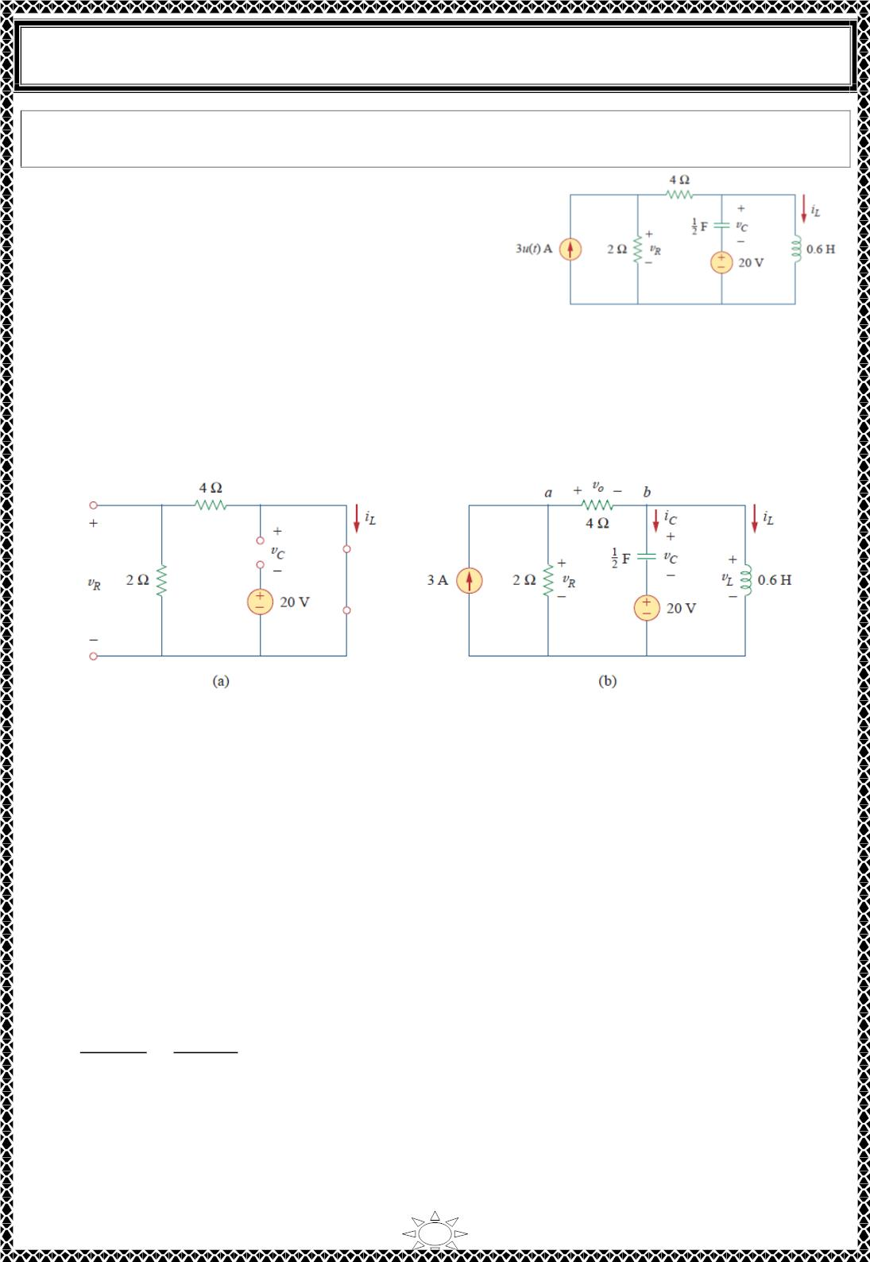
University of Diyala
Engineering College
Electrical Circuits
Example 2: In the circuit of Fig. 1 , calculate: (a) 푖 (0
+), 푣 (0+), 푣 (0+)
,
퐶 푅
퐿
(b)푑푖_{퐿}(0
+)/푑푡, 푑푣 (0+)/푑푡, 푑푣 (0+)/푑푡, (ꢀ)푖 (∞), 푣 (∞), 푣 (∞)
푐
푅
퐿
푐
푅
.
Solution:
−
(a) For 푡 < 0, 3푢(푡) = 0. At 푡 = 0 since the circuit
has reached steady state, the inductor can be replaced
by a short circuit, while the capacitor is replaced by
an open circuit as shown in Fig. 2(a). From this figure
we obtain
Fig. 1
푖 (0−) = 0, 푣 (0−) = 0, 푣 (0−) = ꢁ20푉
(1.1)
퐿
푅
퐶
Although the derivatives of these quantities at 푡 = 0⁻ are not required, it is evident that
they are all zero, since the circuit has reached steady state and nothing changes.
Trail Version
Trail Version
Trail Version
Trail Version
Trail Version
Trail Version
Trail Version
Trail Version
Trail Version
Trail Version
Trail Version
Trail Version
Trail Version
Fig. 2 The circuit in Fig. 1 for: (a) 푡 = 0^{−, (푏)푡 = 0+}
For 푡 > 0, 3푢(푡) = 3, so that the circuit is now equivalent to that in Fig. 2(b). Since the
inductor current and capacitor voltage cannot change abruptly,
푖 (0+) = 푖 (0−) = 0, 푣 (0+) = 푣 (0−) = ꢁ20푉
(1.2)
퐿
퐿
퐶
퐶
Although the voltage across the 4 ꢁ 훺 resistor is not required, we will use it to apply KVL
and KCL; let it be called 푣_{표}. Applying KCL at node 푎 in Fig. 2(b) gives
3 =
푣_{푅}(0+) 푣_{표}(0+)
2
ꢂ
4
(1.3)
(1.4)
Applying KVL to the middle mesh in Fig. 2(b) yields
ꢁ푣 (0+) ꢂ 푣 (0+) ꢂ 푣 (0+) ꢂ 20 = 0
푅
표
퐶
4

Slide 4

University of Diyala
Engineering College
Electrical Circuits
Since 푣_{퐶}(0+) = −20푉 from Eq. (1.2), Eq. (1.4) implies that
푣 (0+) = 푣 (0+)
(1.5)
(1.6)
푅
표
From Eqs. (1.3) and (1.5), we obtain
푣 (0+) = 푣 (0+) = 4푉
푅
표
(b) Since 퐿푑푖 /푑푡 = 푣 ,
ꢀ
ꢀ
푑푖ꢀ(0+) 푣ꢀ(0+)
=
푑푡
퐿
But applying KVL to the right mesh in Fig. 2(b) gives
푣 (0+) = 푣 (0+) ꢁ 20 = 0
ꢀ
푐
Hence,
^{푑푖}ꢀ⁽⁰⁺⁾
Trail Version
Trail Version
Trail Version
Trail Version
Trail Version
Trail Version
Trail Version
Trail Version
Trail Version
Trail Version
Trail Version
Trail Version
Trail Version
(1.7)
푑푡
= 0
Similarly, since ꢂ푑푣 /푑푡 = 푖 , then 푑푣 /푑푡 = 푖 /ꢂ. We apply KCL at node 푏 in Fig.
2(b) to get 푖_{퐶}:
퐶
퐶
퐶
퐶
ꢆ
ꢃ (ꢅ )
= 푖 (0+) ꢁ 푖 (0+)
퐶 ꢀ
ꢄ
(1.8)
(1.9)
ꢇ
Since 푣_{표}(0+) = 4 and
푖 (0+) = 0, 푖 (0+) = 4/4 = 1
A. Then
ꢀ
퐶
ꢆ
ꢆ
ꢈꢃ (ꢅ )
ꢋ (ꢅ )
ꢍ
ꢉ
ꢌ
ꢈꢊ
=
퐶
=
= 2푉/푠
ꢅ.5
To get 푑푣_{푅}(0+)/푑푡, we apply KCL to node and obtain
푎
3 =
푣_{푅} 푣_{표}
2
ꢁ
4
Taking the derivative of each term and setting 푡 = 0⁺ gives
ꢆ
ꢆ
ꢈꢃ (ꢅ )
ꢈꢃ (ꢅ )
0 = 2
ꢎ
ꢁ
ꢄ
(1.10)
ꢈꢊ
ꢈꢊ
We also apply KVL to the middle mesh in Fig. 2(b) and obtain
−푣 ꢁ 푣 ꢁ 20 ꢁ 푣 = 0
푅
푐
표
Again, taking the derivative of each term and setting 푡 = 0⁺ yields
5

Slide 5
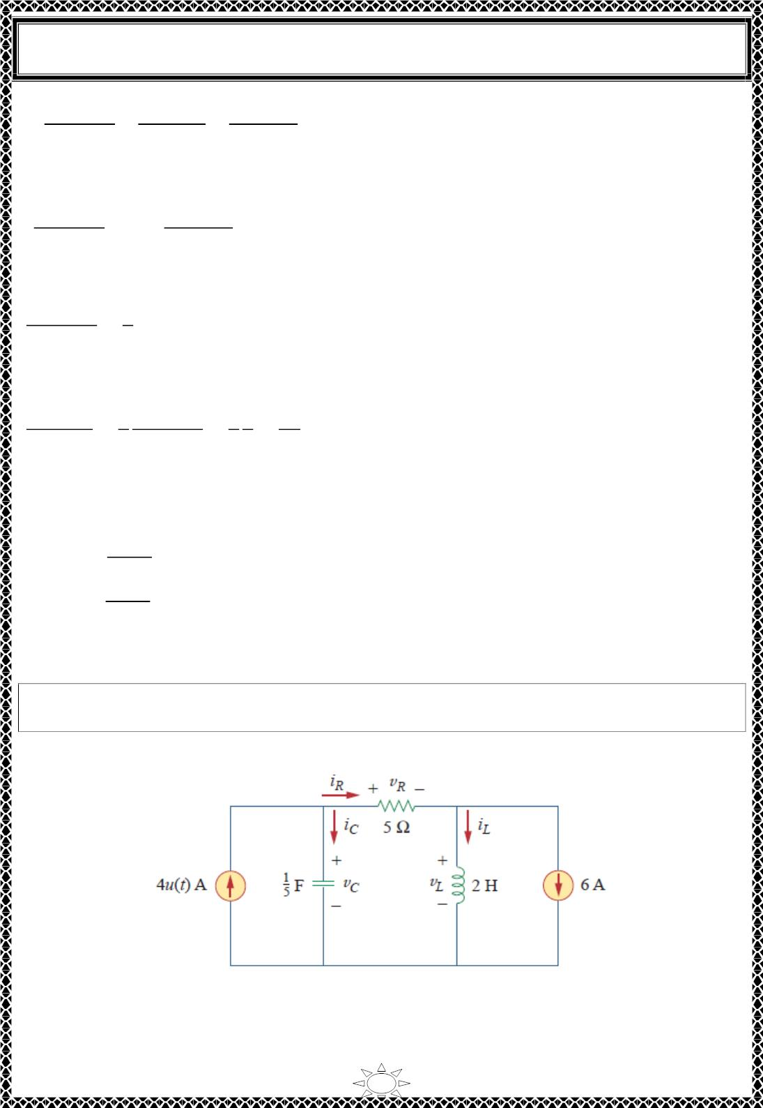
University of Diyala
Engineering College
Electrical Circuits
푑푣_{푅}(0+) 푑푣_{푐}(0+) 푑푣_{표}(0+)
−
푑푡
ꢀ
푑푡
ꢀ
푑푡
= 0
Substituting for 푑푣_{퐶}(0+)/푑푡 = 2 gives
푑푣_{푅}(0+)
푑푡
= 2 ꢀ
푑푣_{표}(0+)
푑푡
(1.11)
From Eqs. (1.10) and (1.11), we get
푑푣_{푅}(0+)
푑푡
2
= 푉/푠
3
We can find 푑푖_{푅}(0+)/푑푡 although it is not required. Since
푣 = 5푖 ,
푅
푅
푑푖_{푅}(0+) 1 푑푣_{푅}(0+) 1 2
2
푑푡
=
푑푡
=
=
퐴/푠
5
5 3 15
(c) As 푡 → ∞, the circuit reaches steady state. We have the equivalent circuit in Fig. 2(a)
except that the 3‐퐴 current source is now operative. By current division principle,
Trail Version
Trail Version
Trail Version
Trail Version
Trail Version
Trail Version
Trail Version
Trail Version
Trail Version
Trail Version
Trail Version
Trail Version
Trail Version
푖_{퐿}(∞) =
푣_{푅}(∞) =
2
3퐴 = 1퐴
(1.12)
2 ꢀ 4
4
2 ꢀ 4
3퐴×2 = 4푉, 푣_{퐶}(∞) = −20푉
H.W.2: For the circuit in Fig. 1, find: (a) 푖 (0
+), 푣 (0+), 푣 (0+)
, (b)
푑푖_{퐿}(0+)/푑푡,
퐿
퐶
푅
푑푣 (0+)/푑푡, 푑푣 (0+)/푑푡, (ꢁ)푖 (∞), 푣 (∞), 푣 (∞) .
퐶
푅
퐿
퐶
푅
Answer: (a) −ퟔ푨, ퟎ, ퟎ, (풃)ퟎ, ퟐퟎ푽/풔, ퟎ, (풄) − ퟐ푨, ퟐퟎ푽, ퟐퟎ푽.
Fig. 1
6

Slide 6
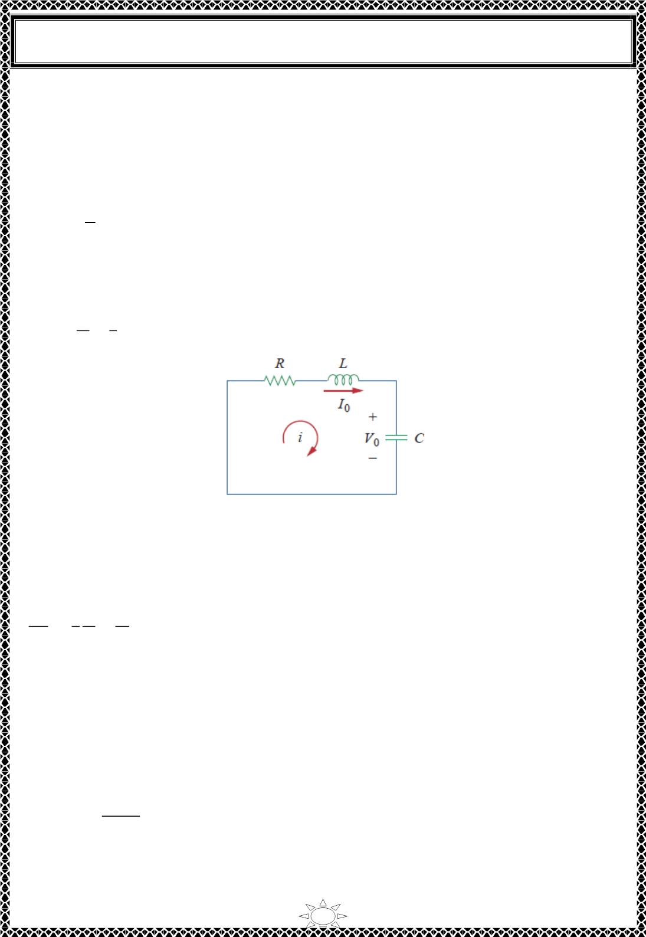
University of Diyala
Engineering College
Electrical Circuits
3) The Source‐Free Series RLC Circuit
Consider the series RLC circuit shown in Fig. 3.1. The circuit is being excited by the energy
initially stored in the capacitor and inductor. The energy is represented by the initial
capacitor voltage 푉 and initial inductor current 퐼 . Thus, at 푡 = ꢀ,
0
0
1
0
푣(푂) = ∫ 푖 푑푡 = 푉
(3.1a)
(3.1b)
퐶
−∞
0
푖(ꢀ) = 퐼₀
Applying KVL around the loop in Fig. 3.1,
ꢁꢂ
ꢄ
ꢃ
푅푖 + 퐿 + ꢆ 푖 푑푡 = ꢀ
(3.2)
ꢁꢃ
ꢅ
−∞
Trail Version
Trail Version
Trail Version
Trail Version
Trail Version
Trail Version
Trail Version
Trail Version
Trail Version
Trail Version
Trail Version
Trail Version
Trail Version
Fig. 3.1. A source-free series RLC circuit.
To eliminate the integral, we differentiate with respect to 푡 and rearrange terms. We get
2
d ꢂ
ꢁꢃ²
+
ꢇ ꢁꢂ
ꢈ ꢁꢃ
ꢂ
+
= ꢀ
ꢈꢅ
(3.3)
This is a second‐order differential equation and is the reason for calling the RLC circuits in this
lecture second‐order circuits. To solve such a second‐order differential equation requires that
we have two initial conditions, such as the initial value of 푖 and its first derivative or initial
values of some 푖 and 푣. The initial value of 푖 is given in Eq. (8.2b). We get the initial value
of the derivative of 푖 from Eqs. (3.1a) and (3.2); that is,
푅푖(푂) + 퐿
푑푖(ꢀ)
+ 푉₀ = ꢀ
푑푡
or
7

Slide 7

University of Diyala
Engineering College
Electrical Circuits
푑푖(0)
푑푡
1
= − (푅퐼 + 푉 )
(3.4)
퐿
0
0
With the two initial conditions in Eqs. (3.1b) and (3.4), we can now solve Eq. (3.4). Our
experience in the preceding lecture on first‐order circuits suggests that the solution is of
exponential form. So we let
ꢀ = 퐴푒^{푠푡}
(3.5)
where 퐴 and ꢁ are constants to be determined. Substituting Eq. (3.5) into Eq. (3.3) and
carrying out the necessary differentiations, we obtain
퐴ꢁ²푒^{푠푡} +
or
퐴푅
ꢂ
ꢁ푒^{푠푡} +
퐴
푒^{푠푡} = ꢃ
ꢂ퐶
ꢄ
1
퐴푒^{푠푡}(ꢁ² + ꢁ + ) = ꢃ
(3.6)
퐿
퐿ꢅ
푠푡
Since ꢀ = 퐴푒 is the assumed solution we are trying to find, only the expression in
parentheses can be zero:
Trail Version
Trail Version
Trail Version
Trail Version
Trail Version
Trail Version
Trail Version
Trail Version
Trail Version
Trail Version
Trail Version
Trail Version
ꢄ
Trail Version
1
ꢁ² + ꢁ + = ꢃ
(3.7)
퐿
퐿ꢅ
This quadratic equation is known as the characteristic equation of the formula to differential
Eq. (3.3), since the roots of the equation dictate the character of ꢀ. The two roots of Eq. (3.7)
are
ꢄ
ꢄ
1
ꢁ₁ = − + √( )² −
(3.8a)
(3.8b)
2퐿
ꢄ
2퐿
ꢄ
퐿ꢅ
1
ꢁ₂ = − − √( )² −
2퐿
2퐿
퐿ꢅ
A more compact way of expressing the roots is
ꢁ = −훼 + ꢆ훼² − 휔², ꢁ = −훼 − ꢆ훼² − 휔²
(3.9)
1
0
2
0
where
ꢄ
1
훼 = , 휔₀ =
(3.10)
2퐿
ꢇ퐿ꢅ
The roots ꢁ and ꢁ are called natural frequencies, measured in nepers per second (푵풑/풔) ,
1
2
because they are associated with the natural response of the circuit; 휔₀ is known as the
resonant frequency or strictly as the undamped natural frequency, expressed in radians per
second (풓풂풅/풔) ;and 훼 is the neper frequency or the damping factor, expressed in nepers per
second. In terms of 훼 and 휔₀, Eq. (3.7) can be written as
8

Slide 8
Trail Version
Trail Version
Trail Version
Trail Version
Trail Version
Trail Version
Trail Version
Trail Version
Trail Version
Trail Version
Trail Version
Trail Version
Trail Version

Slide 9

University of Diyala
Engineering College
Electrical Circuits
Overdamped Case (휶 > 흎_{ퟎ})
2
From Eqs. (3.8) and (3.9), 훼 > 휔 implies 퐶 > 4퐿/푅 . When this happens, both roots
0
푠
1
and 푠₂ are negative and real. The response is
푖(푡) = 퐴 푒^{ꢀ ꢂ} + 퐴 푒^{ꢀ ꢂ}
(3.13)
1
ꢁ
2
ꢃ
which decays and approaches zero as 푡 increases. Fig. 3.2(a) illustrates a typical overdamped
response.
Critically Damped Case (휶 = 흎_{ퟎ})
2
When 훼 = 휔 , 퐶 = 4퐿/푅 and
0
ꢄ
푠 = 푠 = −훼 = −
(3.14)
1
2
2ꢅ
For this case, Eq. (3.12) yields
푖(푡) = 퐴 푒^{ꢆꢇꢂ} + 퐴 푒^{ꢆꢇꢂ} = 퐴 푒^{ꢆꢇꢂ}
Trail Version
Trail Version
Trail Version
Trail Version
Trail Version
Trail Version
Trail Version
Trail Version
Trail Version
Trail Version
Trail Version
Trail Version
Trail Version
1
2
3
where 퐴 = 퐴 + 퐴 . This cannot be the solution, because the two initial conditions cannot
3
1
2
be satisfied with the single constant 퐴₃. What then could be wrong? Our assumption of an
exponential solution is incorrect for the special case of critical damping. Let us go back to
Eq. (3.3). When 훼 = 휔₀ = 푅/ꢈ퐿, Eq. (3.3) becomes
푑²푖
푑푡²
푑푖
+ ꢈ훼 + 훼²푖 = ꢉ
푑푡
or
ꢊ
ꢊꢋ
ꢊꢋ
( + 훼푖) + 훼( + 훼푖) = ꢉ
(3.15)
(3.16)
ꢊꢂ ꢊꢂ
If we let
ꢊꢂ
ꢊꢋ
푓 = + 훼푖
ꢊꢂ
then Eq. (8. 15) becomes
ꢊꢌ
+ 훼푓 = ꢉ
ꢊꢂ
which is a first‐order differential equation with solution 푓 = 퐴₁푒ꢆꢇꢂ, where is a constant.
퐴
Equation (3.16) then becomes
1
푑푖
+ 훼푖 = 퐴₁푒^{ꢆꢇꢂ}
푑푡
10

Slide 10
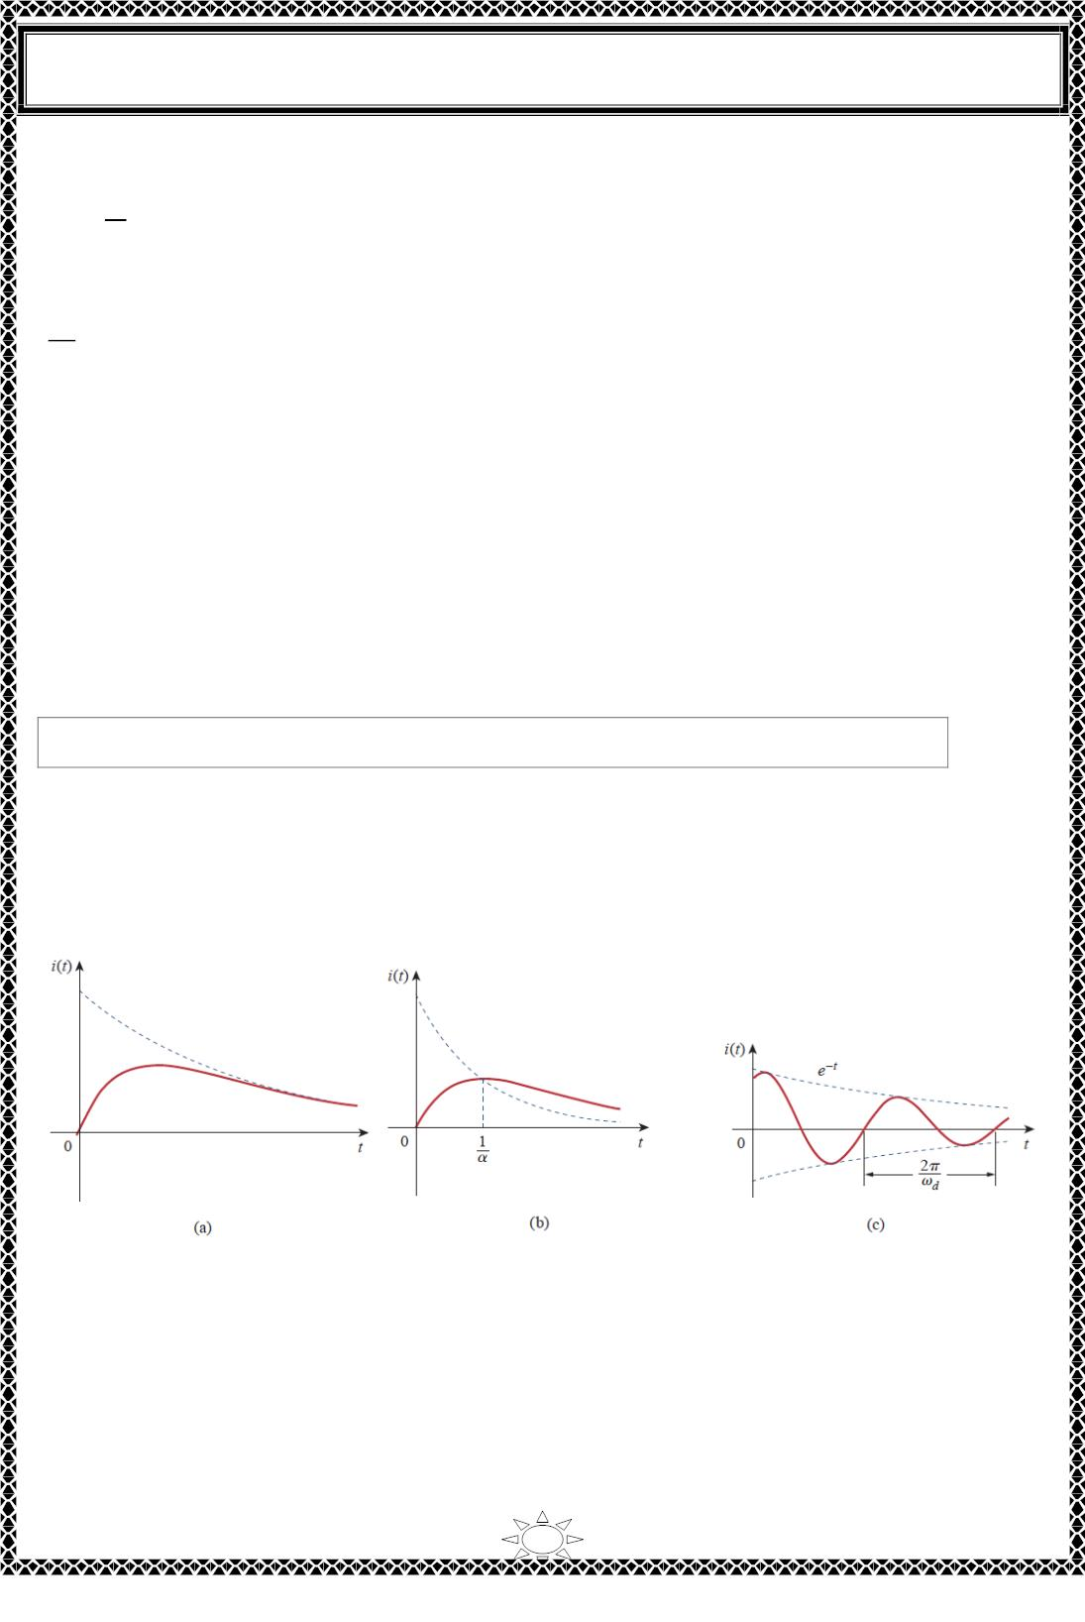
University of Diyala
Engineering College
Electrical Circuits
or
푑푖
푒^{훼푡}
+ 푒훼푡ꢀꢁ = 퐴₁
(3.17)
(3.18)
푑푡
This can be written as
ꢂ
(푒^{훼푡}ꢁ) = 퐴₁
ꢂꢃ
Integrating both sides yields
푒^{훼푡}ꢁ = 퐴₁ꢃ + 퐴₂
or
ꢁ = (퐴 ꢃ + 퐴 )푒−훼푡
(3.19)
1
2
where 퐴 is another constant. Hence, the natural response of the critically damped circuit
2
is a sum of two terms: a negative exponential and a negative exponential multiplied by a
linear term, or
Trail Version
Trail Version
Trail Version
Trail Version
Trail Version
Trail Version
Trail Version
Trail Version
Trail Version
Trail Version
Trail Version
Trail Version
Trail Version
ꢁ(ꢃ) = (퐴 + 퐴 ꢃ)푒−훼푡
(3.20)
2
1
A typical critically damped response is shown in Fig. 3.2 (b). In fact, Fig. 3.2 (b) is a sketch
of ꢁ(ꢃ) = ꢃ푒^{−훼푡}, which reaches a maximum value of
at
푒⁻¹/ꢀ ꢃ = ꢄ/ꢀ
, one time constant,
and then decays all the way to zero.
Fig. 3.2 (a) Overdamped response, (b) critically damped response, (c) underdamped
response.
11

